Slide 1


MUSIC GENRE CLASSIFICATION

Slide 2

GROUP MEMBERS
KR ABISHEKRASWANTH - CB.EN.U4CCE20001
AKSHARA R - CB.EN.U4CCE20003
R RANGASHREE DHANVANTH - CB.EN.U4CCE20048
SWATHI P - CB.EN.U4CCE20062

Slide 3

INTRODUCTION
Audio processing is one of the most complex tasks in data science as compared to image processing and other classification techniques.
One such application is music genre classification which aims to classify the audio files in certain categories of sound to which they belong.
The application is very important and requires automation to reduce the manual error and time because if we must classify the music manually then one has to listen out each file for the complete duration.
So, to automate the process we use Machine learning algorithms.

Slide 4
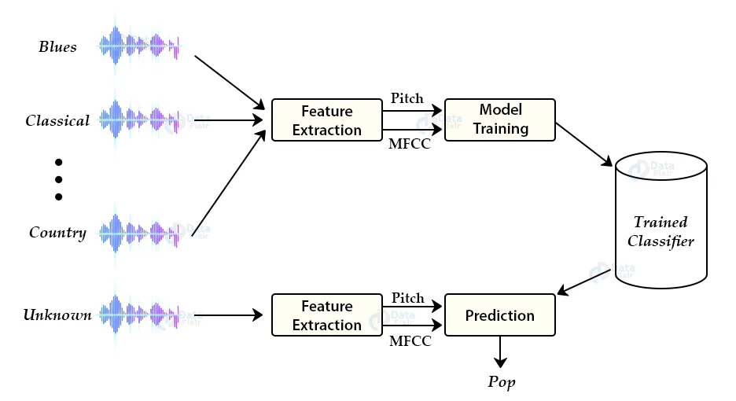
METHODOLOGY
We have extracted all the features of the audio file using librosa.
There are 57 types of features to classify a particular model and predicting the exact wav file sent.

Slide 5

DATASET OVERVIEW
Genres original — A collection of 10 genres with 100 audio files each, all having a length of 30 seconds (the famous GTZAN dataset, the MNIST of sounds)
Images original — A visual representation for each audio file. One way to classify data is through neural networks because NN’s usually take in some sort of image representation.
2 CSV files — Containing features of the audio files. One file has for each song (30 seconds long) a mean and variance computed over multiple features that can be extracted from an audio file. The other file has the same structure, but the songs are split before into 3 seconds audio files.
The classes to which audio files belong are Blues, Hip- hop, Classical, Pop, Disco, Country, Metal, Jazz, Reggae, rock.
https://www.kaggle.com/datasets/andradaolteanu/gtzan-dataset-music-genre-classification​

Slide 6
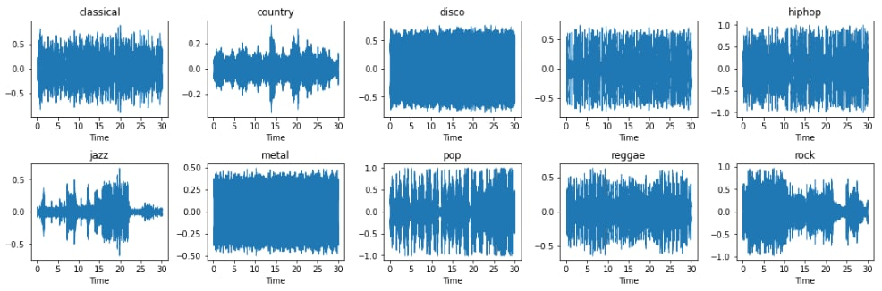
DATA VISUALISATION
Blues

Slide 7
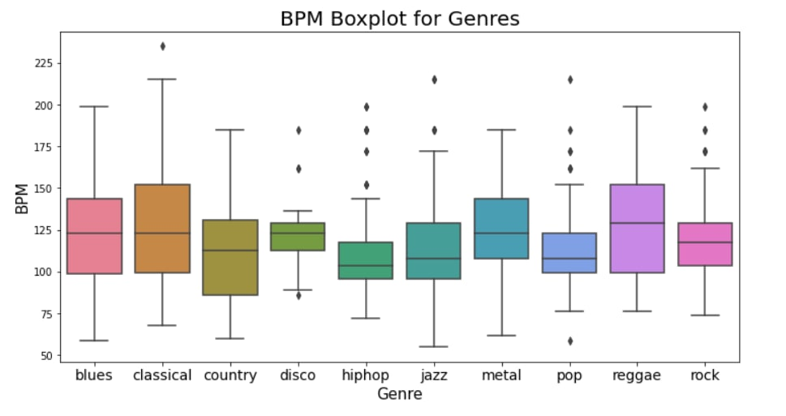
BOX PLOTS

Slide 8
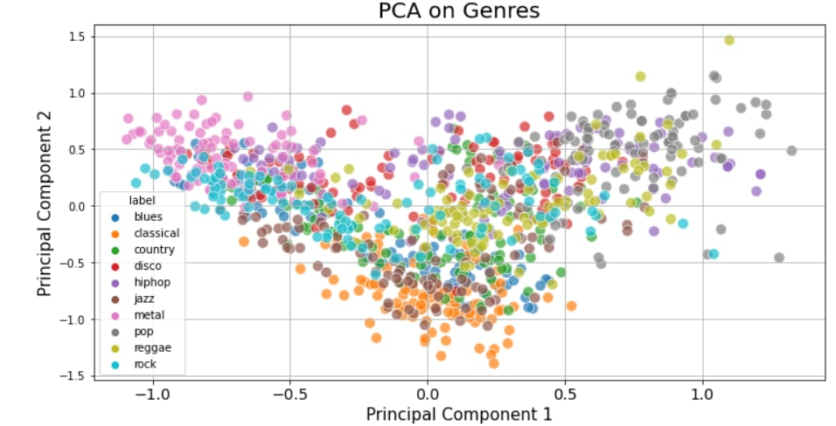
DATA REDUCTION – PRINCIPAL COMPONENT ANALYSIS

Slide 9
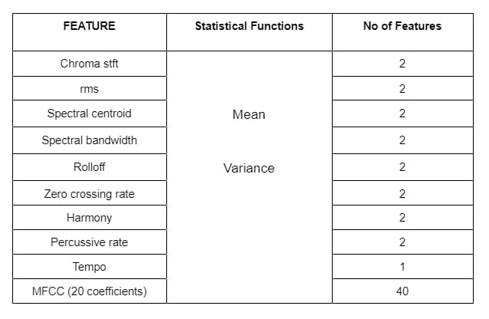
FEATURE
EXTRACTION​

Slide 10

MODEL TRAINING
Built four classifier models:
1. KNN
2. SVM
3. Decision Tree
4. Naïve Bayes
The training set consists of 80% of dataset and is used to train these models with the labels
The test set consists of 20% of dataset and is used to test the models by predicting the labels.
Classification report and accuracy of each model gives us the accurate classifier.

Slide 11
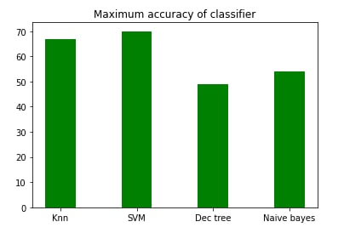
CONCLUSION
This project studies several methods of music genre classification. We study several audio feature extraction methods using digital signal processing methods, including MFCC (mel-frequency cepstral coefficients), ZCR (zero-crossing rate), etc.
We use different classifiers like decision tree or SVM, and the other one is the combination with a series of MFCC coefficients with KNN and K-Means clustering.
We quantitatively compare the performance of classifying jazz, classical, metal, pop, etc for all the models, and find that the SVM model gives a better result with 70% accuracy.

Slide 12

1. Musical Genre Classification of Audio Signal’,George Tzanetakis and Perry Cook,IEEE Transactions on Speech and Audio Processing, 10(5), July 2002.
2. https://docs.google.com/presentation/d/1Y024bJxO-XtvH163Te59dOHUYZXpMY3nDPI2lb48RKo/htmlpresent
3. https://www.analyticsvidhya.com/blog/2022/03/music-genre-classification-project-using-machine-learning-techniques/
4. https://www.researchgate.net/publication/324218667_Music_Genre_Classification_using_Machine_Learning_Techniques
5. https://www.researchgate.net/publication/329396097_Music_Genre_Classification_and_Recommendation_by_Using_Machine_Learning_Techniques
REFRENCES

Slide 13

THANK YOU

